Slide 1
MOBILE PROGRAMING
Instructor: Vo Tan Toan
Theory: 30 hours
Practice: 30 hours
Course material developed by:
Vo Tan Toan (vttoan@hcmuaf.edu.vn)

Slide 2





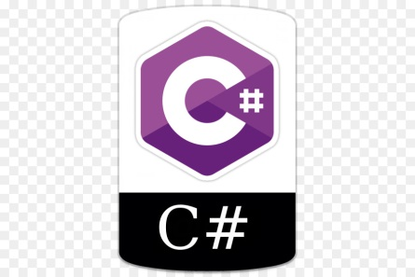

Mobile programing
Native App
Cross Flatform
Framework, IDE
Cost Devide
Cost google Playservice, Appstore
Android vs IOS

Slide 3
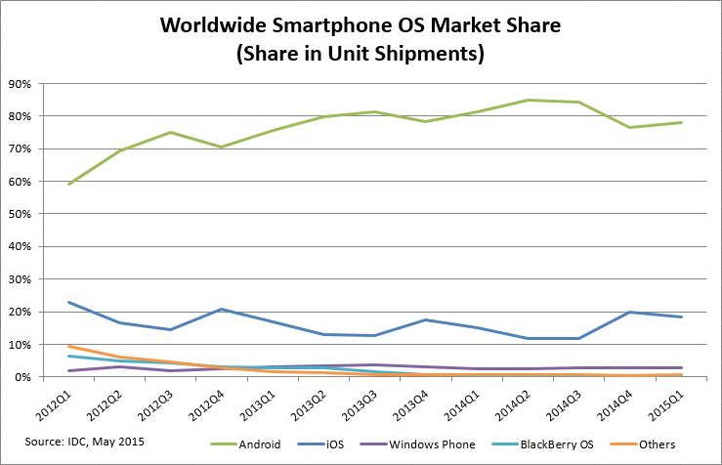
Mobile programing

Slide 4
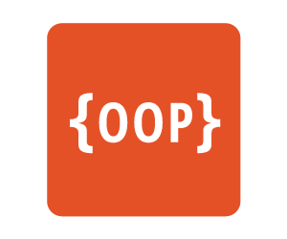

Subject Requirements
Understand Java Programming
Unserstand Object Oriented in Programming
Understand structure of XML, HTML files

Slide 5
Course Topics
Introduction to Android Programming
Part1: View and Layout
Part2: Activity, Intent, Event, Menu
Part3: Fragment, Listview, Adapter
Part4: Http Connection, Android Thread, Async Task
Part5: Sqlite Database
Part6: Advanced API (Youtube, Facebook, Rss, Google map, Webservices … )

Slide 6
Grade
Lab: 20%
Middle exam: 30%
Final project: 50% (3 – 4 member)
Project Grading
It is expected that everyone is a good programmer.
Comments (documentation) are required.
Structured, readable code is required.
60% of the grade depends on the quality of the code
(No sharing of code in any form)

Slide 7
Literatute
Head First Android Development, 2011
Android based Mobile Application Development and its Security, 2012
The future of teaching programming is on mobile devices, July 2012
Core Java 2 – Volume II, SunPress, 2001

Slide 8
Introduction Mobile programing
References
Tools
Android SDK
Creating a Project
Project Components
XML
R Class
Layouts
Strings
Manifest File

Slide 9
References
This lesson is a brief overview of some major concepts
Developer’s Guide
http://developer.android.com/guide/index.html
API Reference
http://developer.android.com/reference/packages.html

Slide 10
Tool
Phone – Virtual machine
Eclipse ( http://www.eclipse.org/downloads/ )
Android Plugin (ADT)
Android Studio (https://developer.android.com/studio)
Android SDK ( http://developer.android.com/sdk/index.html )

Slide 11
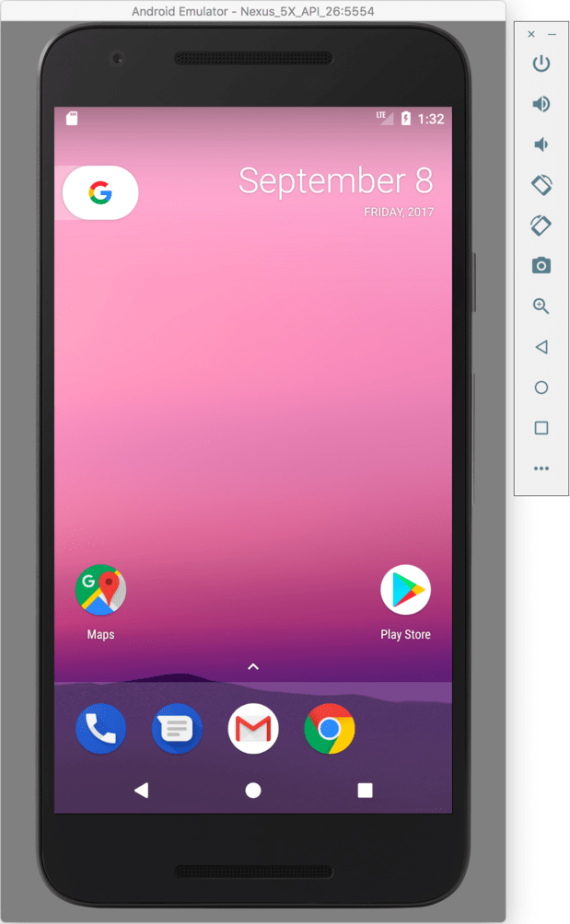


Android SDK
Once installed open the SDK Manager
Install the desired packages
Create an Android Virtual Device (AVD)

Slide 12
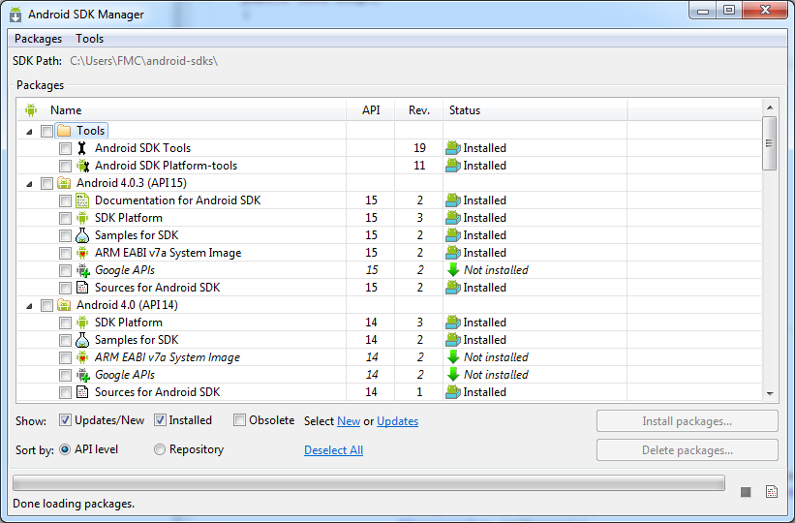
SDK Manager

Slide 13
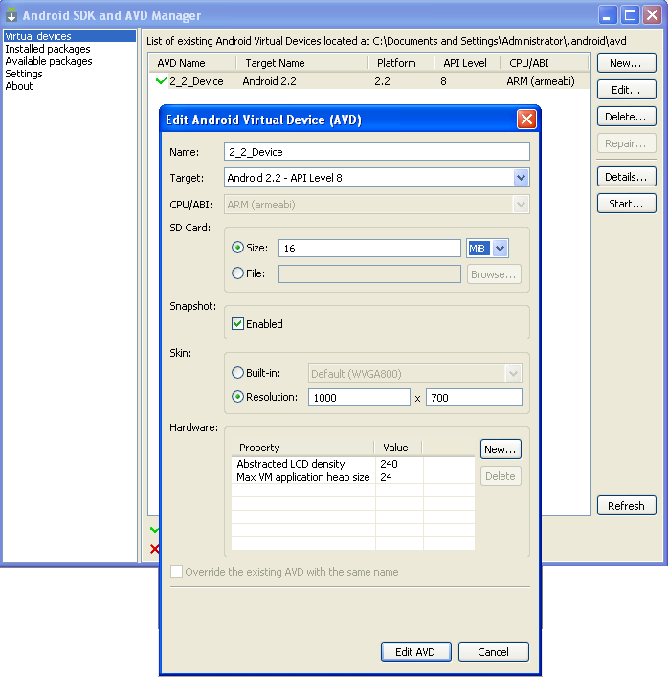
AVD

Slide 14
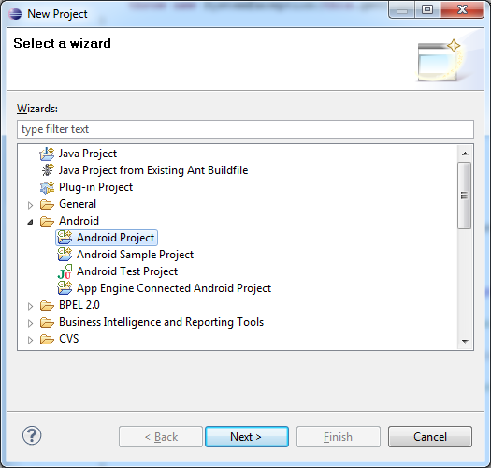
Creating a Project
In Eclipse, select “File -> New -> Project….”, “Android Project”, and input your application detail. Eclipse will create all the necessary Android project files and configuration.

Slide 15
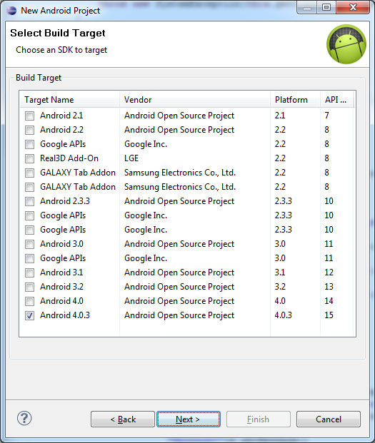
Creating a Project

Slide 16
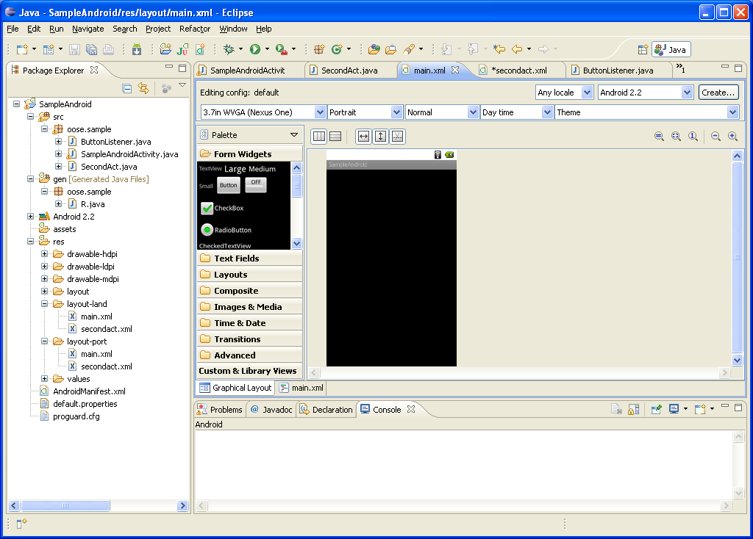
Layouts (2)

Slide 17
Project Components
src – your source code
gen – auto-generated code (usually just R.java)
Included libraries
Resources
Drawables (like .png images)
Layouts
Values (like strings)
Manifest file

Slide 18
XML
Used to define some of the resources
Layouts (UI)
Strings
Manifest file
Shouldn’t usually have to edit it directly, Eclipse can do that for you
Preferred way of creating UIs
Separates the description of the layout from any actual code that controls it
Can easily take a UI from one platform to another

Slide 19
R Class
Auto-generated: you shouldn’t edit it
Contains IDs of the project resources
Use findViewById and Resources object to get access to the resources
Ex. Button b = (Button)findViewById(R.id.button1)
Ex. getResources().getString(R.string.hello));

Slide 20
Layouts (1)
Eclipse has a great UI creator
Generates the XML for you
Composed of View objects
Can be specified for portrait and landscape mode
Use same file name, so can make completely different UIs for the orientations without modifying any code

Slide 21
Layouts (2)

Slide 22
Strings
In res/values
strings.xml
Application wide available strings
UI components made in the UI editor should have text defined in strings.xml
Strings are just one kind of ‘Value’ there are many others

Slide 23
Manifest File
The application must declare all its components in this file, which must be at the root of the application project directory.
The manifest does a number of things in addition to declaring the application's components, such as:
Identify any user permissions the application requires, such as Internet access or read-access to the user's contacts.
Declare the minimum API Level required by the application, based on which APIs the application uses.
Declare hardware and software features used or required by the application, such as a camera, bluetooth services, or a multitouch screen.

Slide 24
Manifest File
Declaring components
You must declare all application components this way:
<activity> elements for activities
<service> elements for services
<receiver> elements for broadcast receivers
<provider> elements for content providers

Slide 25
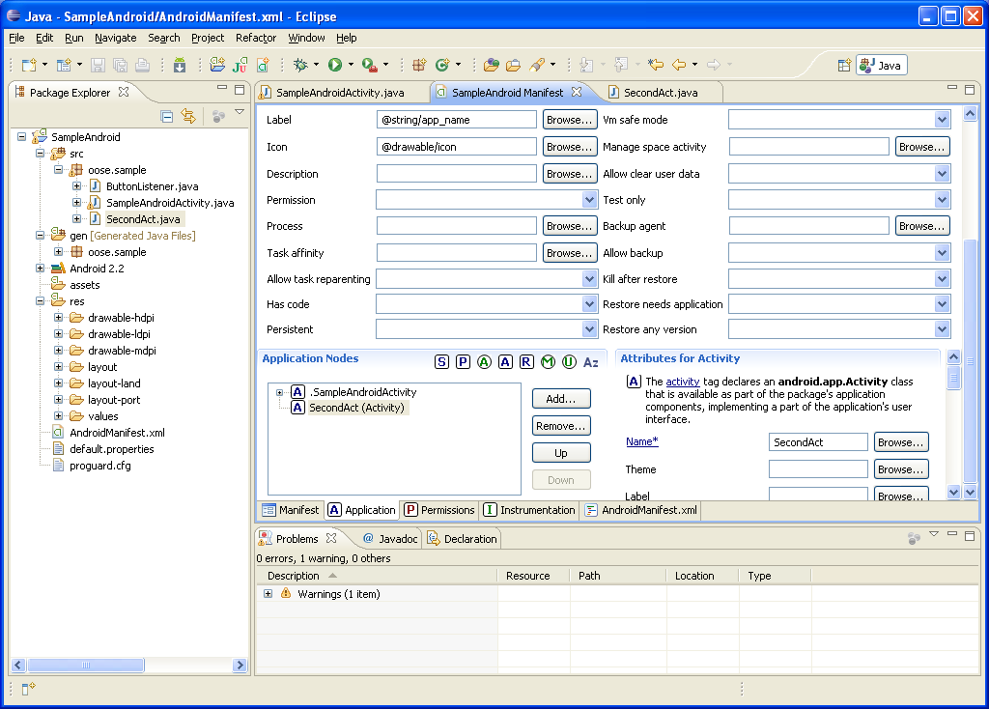
Manifest File – Adding an Activity

Slide 26
Java-Based Approach: Template
public class SomeName extends Activity {
@Override
public void onCreate(Bundle savedInstanceState) {
super.onCreate(savedInstanceState);
String message = "...";
LinearLayout window = new LinearLayout(this);
window.setVariousAttributes(…);
Button b = new Button(this);
b.setText("Button Label");
b.setOnClickListener(new SomeHandler());
mainWindow.addView(b);
...
setContentView( window );
}
private class SomeHandler implements OnClickListener {
@Override
public void onClick(View clickedButton ){
doSomething(...);
}
} }

Slide 27
XML-Based Approach: Template
Java
public class SomeClass extends Activity {
@Override
public void onCreate(Bundle savedInstanceState) {
super.onCreate(savedInstanceState);
setContentView(R.layout.main);
}
public void handlerMethod (View clickedButton) {
String someName = getString (R.string.some_name);
doSomethingWith(someName);
} }

Slide 28
XML-Based Approach: Template
XML
res/values/strings.xml
<?xml version="1.0" encoding="utf-8"?>
<resources>
<string name="some_name">…</string>
…
</resources>
res/layout/main.xml
<?xml version="1.0" encoding="utf-8"?>
<LinearLayout …>
<TextView … />
<Button … android:onClick="handlerMethod" />
</LinearLayout>

Slide 29
Basic widgets
TextView
TextView allocates an area of the screen to display text
<TextView android:id="@+id/counter“
android:layout_width="fill_parent"
android:layout_height="wrap_content"
android:gravity="center"
android:padding="10dp"
android:text="@string/sample_time"
android:textSize="50sp" >
</TextView>

Slide 30
Basic widgets
Buttons
Represents a push-button widget.
Push-buttons can be pressed, or clicked, by the user to perform an action.
<Button android:id="@+id/finished"
android:layout_width="match_parent“
android:layout_height="wrap_content“
android:text="@string/finished" >
</Button>

Slide 31

Mobile Programming
Thank you!

